Slide 1
Structured Text
Studio 5000 and Siemens
Overview
© 2022 John Sefcovic and Oakland Community College.

Slide 2
Structured Text
Overview
Structured Text programming uses statements to define the execution logic of the procedures for the controlled application.
The instructions in Structured Text programming are primarily used in process control, mathematical equations, strings, and arrays.
Other programming instructions are included to allow the Structured Text to be inclusive for the procedure being programmed.
In both Studio 5000 and Siemens the basic instructions are the same.
Other instructions, such as, Timers and Counters operate similar to the Ladder Logic instructions.
There are syntax differences between a Studio 5000 and Siemens Timers and Counters in Ladder Logic and Structure Text versions.

Slide 3

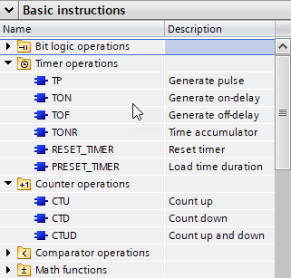
Structured Text
Overview
The Timer and Counter, and other instructions are selected from the Instruction lists.
STUDIO 5000
SIEMENS TIA

Slide 4
Structured Text
Expressions
Format of a Structured Text statement:
tag := expression;
Tag
:=
expression
a data value in the program.
the assignment operator.
the value, logic, or instruction assigned to the tag.
All lines must end with a semi-colon ;
Structured text is not case sensitive.
The use of Tab (indent) and Enter (separate lines) to make the structured text easier to read. They have no effect on the execution of the structured text.

Slide 5
Structured Text
Expressions
An expression may contain:
A constant value
A tag
An operator
An instruction
STUDIO 5000
SIEMENS TIA
Tag1 := 4
Tag1 := Tag2
Tag1 := Tag2 + Tag3
Tag1 >= Tag2
TONR(Tag4)
"Tag4".TON(IN:=_bool_in_,
PT:=_time_in_,
Q=>_bool_out_,
ET=>_time_out_);

Slide 6
Structured Text
Expressions
NOT OPERATOR
The NOT operator inverts the bit’s value.
Tag1 := NOT Tag2
A value “1” in Tag2 would result in a “0” value in Tag1.
A value “0” in Tag2 would result in a “1” value in Tag1.
Tag1 := Tag2 AND NOT Tag3
Tag1 will have a value “1” when Tag2 has a value “1” and Tag2 have a value “0”. The NOT turns the “0” values to a “1” value for the expression.

Slide 7
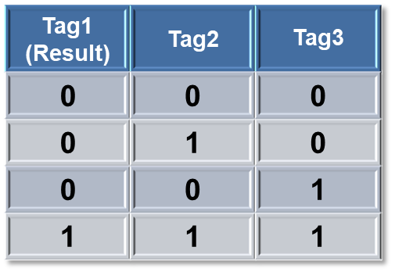
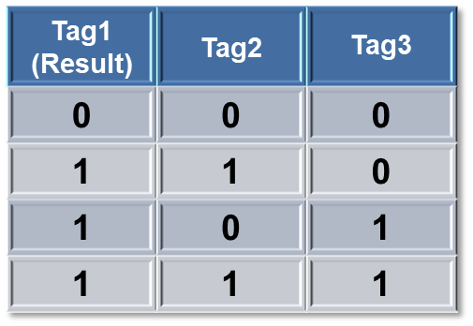
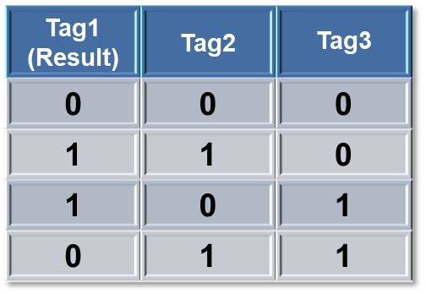
Structured Text
Expressions
LOGIC OPERATORS
TRUTH TABLE and LOGICAL OPERATORS
Each Logical Operator produces a different results
AND
OR
XOR
Tag1:=Tag2 AND Tag3
Tag1:=Tag2 OR Tag3
Tag1:=Tag2 XOR Tag3

Slide 8
Basic Structures STUDIO 5000

Slide 9
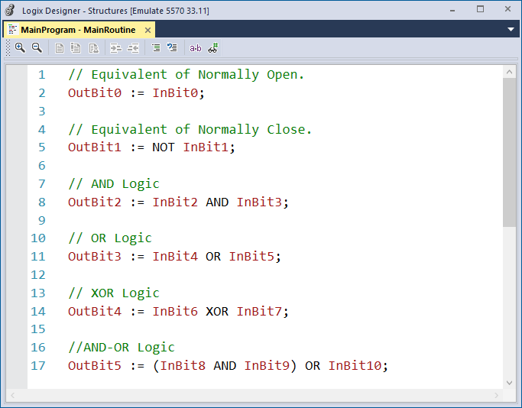

Structured Text
Basic Structures STUDIO 5000
Structured Text equivalent to Ladder Logic Examine On (XIC).

Slide 10

Structured Text
Basic Structures STUDIO 5000
Structured Text equivalent to Ladder Logic Examine Off (XIO).

Slide 11

Structured Text
Basic Structures STUDIO 5000
Structured Text equivalent to Ladder Logic series AND circuit.

Slide 12
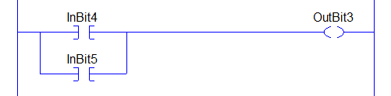
Structured Text
Basic Structures STUDIO 5000
Structured Text equivalent to Ladder Logic parallel OR circuit.

Slide 13
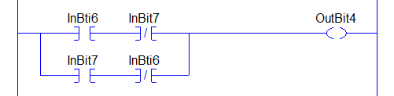
Structured Text
Basic Structures STUDIO 5000
Structured Text equivalent to Ladder Logic interlock XOR circuit.

Slide 14
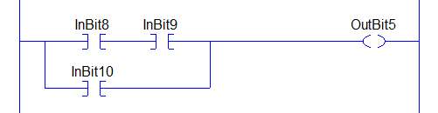
Structured Text
Basic Structures STUDIO 5000
Structured Text equivalent to Ladder Logic AND – OR circuit.

Slide 15
Basic Structures SIEMENS

Slide 16
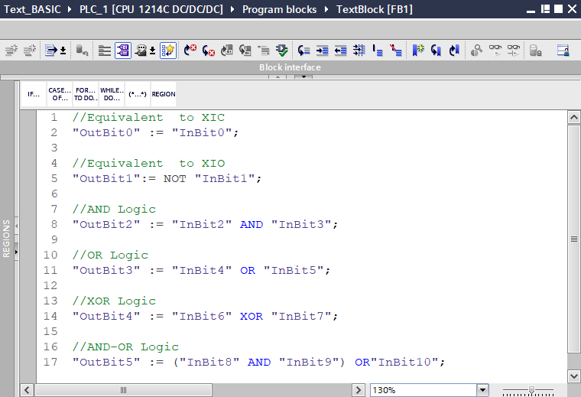
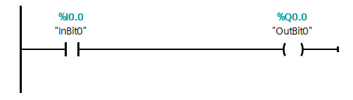
Structured Text
Basic Structures Siemens
Structured Text equivalent to Ladder Logic NO.

Slide 17
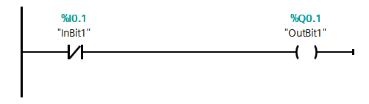
Structured Text
Basic Structures Siemens
Structured Text equivalent to Ladder Logic NO.

Slide 18
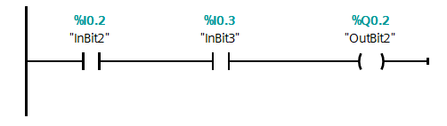
Structured Text
Basic Structures Siemens
Structured Text equivalent to Ladder Logic series AND circuit.

Slide 19
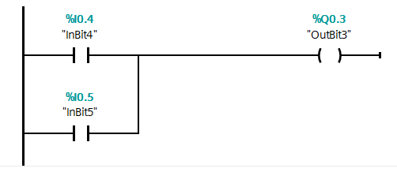
Structured Text
Basic Structures Siemens
Structured Text equivalent to Ladder Logic parallel OR circuit.

Slide 20
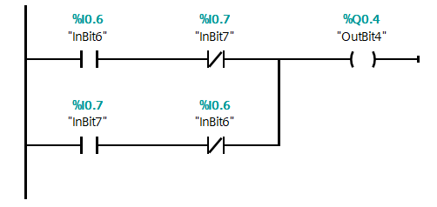
Structured Text
Basic Structures Siemens
Structured Text equivalent to Ladder Logic interlock OR circuit.

Slide 21
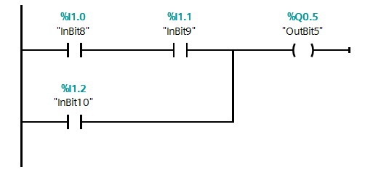
Structured Text
Basic Structures Siemens
Structured Text equivalent to Ladder Logic AND – OR circuit.

Slide 22
Structures Text Comments

Slide 23
Structured Text
Comments
Structured Text can be documented:
// Text preceded by double slashes is a single line comment.
(* An alternative is text which is bounded by parentheses and asterisks are multiple line comments*)
STUDIO 5000
/* Text which is bounded by a slashes and asterisks are multiple line comments*/

Slide 24
Structures Text Constructs

Slide 25
Structured Text
Constructs
Structured Text uses constructs to using Input Conditions to determine Output Actions.
Most common constructs used with Structured Text programming.
IF...THEN
CASE
There are “looping” constructs in Structured Text but are only used in special cases.
FOR...DO
WHILE...DO
REPEAT...UNTIL
The looping constructs causes the program execution to remain in the loop slowing down the PLC scan time. Usually these loops are used in computations or for sorting data.

Slide 26
Structured Text
Constructs
The IF...THEN is the most commonly used construct.
A then is a boundary type of construct, the IF defines the start of the boundary and the END_IF the end of the boundary.
IF the logic condition is TRUE then the logic action statement following the THEN are executed.
IF the logic condition is FALSE then execution goes to the END_IF and the logic action statement in between is not executed.
If logic condition then
logic action;
end_if;
If Tag1 = 1 then
Tag2 := 1;
end_if;

Slide 27
Structured Text
Constructs
If Tag1 = 1 then
Tag2 := 1;
end_if;
IF Tag1 has a value of “1”, THEN the condition is TRUE and Tag2 is set to a value of “1”.
If Tag1 = 1 then
Tag2 := 1;
end_if;
IF Tag1 has a value of “0” the condition is FALSE and program execution goes to the END_IF and Tag2 is not changed.
Notice Tag1 = 1 uses the Equal comparison to determine if the condition is True or False. The := is the Assign a value, see Tag2 logic statement.
Notice the phrase “Tag2 is not changed” when the condition is False.

Slide 28
Structured Text
IMPORTANT Retentative like Latch you turn on you need turn off
Constructs
The major difference in Structure Text is unlike Ladder Logic or Function Block programming the Output Bit retains its value.
In Ladder Logic or Function Block programming if the Input Condition goes FALSE the Output Action then goes FALSE.
In Structure Text when the Input Condition goes FALSE the Output Action remains TRUE.
In a previous scan Tag1 was equal to “1”, assigning a “1” to Tag2.
If Tag1 = 1 then
Tag2 := 1;
end_if;
Now in this scanTag1 has a “0”, program execution goes to the end_if and Tag2 is not changed.

Slide 29
Structured Text
Constructs
In Structure Text when a Input Condition make an output action TRUE. must be programmed to make the Output Action change to FALSE.
If Tag1 = 1 then
Tag2 := 1;
end_if;
There must be programmed an Input Condition to make the Output Action change to FALSE.
If Tag1 = 0 then
Tag2 := 0;
end_if;

Slide 30
Structured Text
Constructs
In ELSE statement can be used to set a tag to “0” when the input Logic Condition is FALSE.
If Tag1 = 1 then
Tag2 := 1;
Else
Tag2 := 0;
end_if;
When Tag1 has a “1” then Tag2 is set to “1” and execution goes to the end_if.
A “0” at Tag1 causes execution to go to the else and resets Tag2 to “0”.
This construct will on each scan…
if Tag1 has a “1” then Tag2 is set to “1”
else Tag2 is set to “0”

Slide 31
Structured Text
Constructs
Structured Text uses Positive Logic in determining a condition.
In the following example, if the START switch is set to 1 the MOTOR turns On.
If START = 1 then
MOTOR := 1;
else;
MOTOR := 0;
end_if;
The Positive Logic assumes for the condition a 1 and does not need to be written into the statement.
If START then
MOTOR := 1;
else;
MOTOR := 0;
end_if;

Slide 32
Structured Text
Constructs
In the previous examples, Tag assignments were shown as separate statements or with an IF statement. These examples use a START – STOP turn switch.
These two ways of turning On and Off the Motor would produce the same result
MOTOR := START_SWITCH;
When the switch is turned to START there is a “1” and the motor turns On.
When the switch is turned to STOP there is a “0” and the motor turns Off.
If START_SWITCH then
MOTOR := 1;
Else
MOTOR := 0;
end_if;
If the switch is turned to START there is a “1” then the motor turns On.
Remember the assumed Positive logic, same as START_SWITCH = 1 .
When the switch is turned to STOP there is a “0” and the else turns motor the Off.

Slide 33
Structures Text Examples

Slide 34
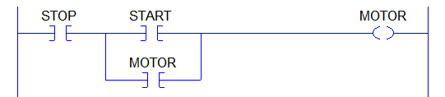
Structured Text
Example Program START – STOP Construct
When more than one Input Condition Tags are required an IF statement must be used.
This example is a STOP – START with a Holding Circuit.
If STOP & (START or MOTOR)then
MOTOR := 1;
Else
MOTOR := 0;
end_if;

Slide 35
Structured Text
Example Program START – STOP Construct
The START is OR’d with the MOTOR to create the Holding Circuit.
Parentheses are used to group the Tags as one logic condition.
If STOP & (START or MOTOR)then
MOTOR := 1;
Else
MOTOR := 0;
end_if;

Slide 36
Structured Text
Example Program START – STOP Construct
STOP is AND’d with the grouped OR’d START - MOTOR Holding Circuit.
Notice the & “and” symbol can be used in place of typing AND.
If STOP & (START or MOTOR)then
MOTOR := 1;
Else
MOTOR := 0;
end_if;

Slide 37
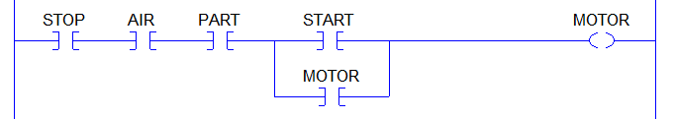
Structured Text
Example Program START – STOP Construct
As with Ladder Logic or Function Block programming Structure Text programs must also include all logic Input Condition to control the Output Action.
If STOP & AIR & PART & (START or MOTOR)then
MOTOR := 1;
Else
MOTOR := 0;
end_if;

Slide 38
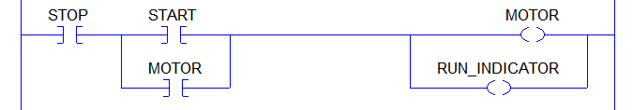
Structured Text
Example Program START – STOP Construct
More than one Output Action can be included in the IF statement’s THEN and ELSE sections.
If STOP & (START or MOTOR)then
MOTOR := 1;
RUN_INDICATOR := 1;
Else
MOTOR := 0;
RUN_INDICATOR := 0;
end_if;

Slide 39
Add and Edit Structure Text STUDIO 5000

Slide 40
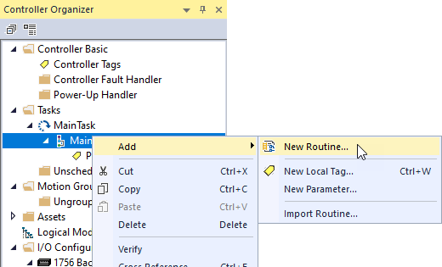
Structured Text
New Structured Text Routine STUDIO 5000
In the Controller Organizer, right click on a MainProgram and then select Add and New Routine.

Slide 41
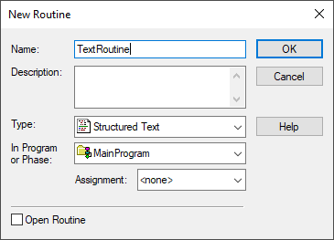
Structured Text
New Structured Text Routine STUDIO 5000
Enter a Name for the routine.
From the dropdown Type:, select Structured Text.

Slide 42
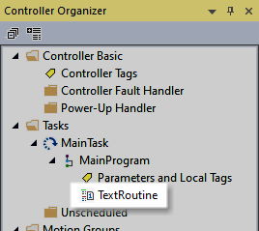
Structured Text
New Structured Text Routine STUDIO 5000
The named program will appear in the Controller Organizer.

Slide 43
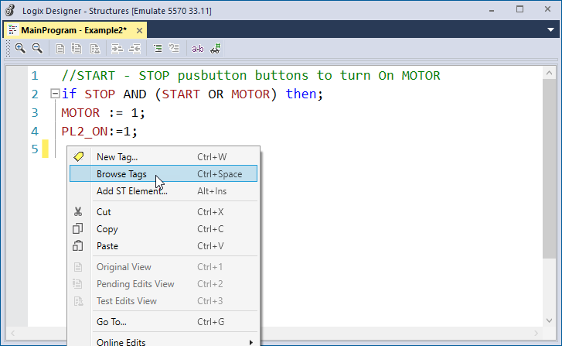
Structured Text
Add Tag with Tag Listing STUDIO 5000
To add a Tag, right click at the location on the line where the Tag is to be placed and select Browse Tags.

Slide 44
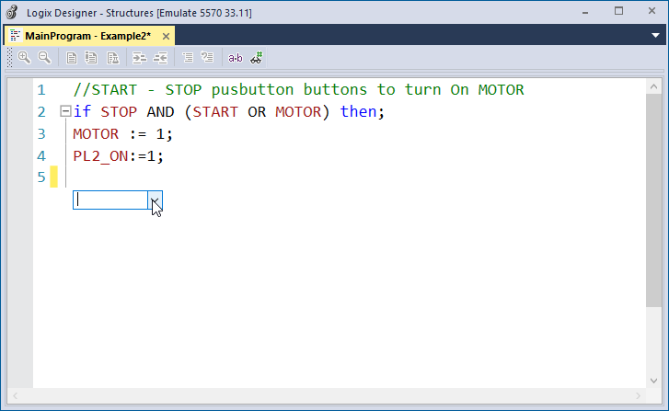
Structured Text
Add Tag with Tag Listing STUDIO 5000
Click on the down arrowhead.

Slide 45
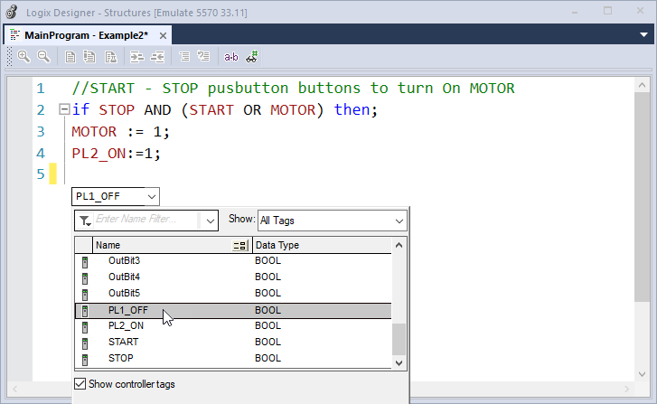
Structured Text
Add Tag with Tag Listing STUDIO 5000
Select the Tag from the Tag List.

Slide 46
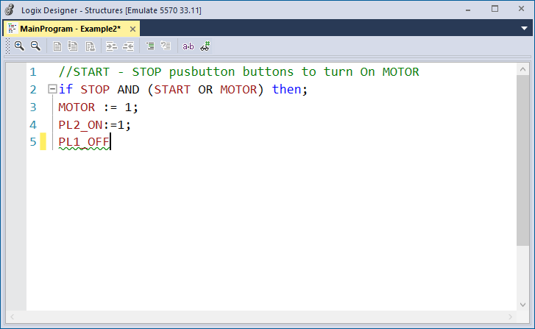
Structured Text
Add Tag with Tag Listing STUDIO 5000
Tag is added.

Slide 47
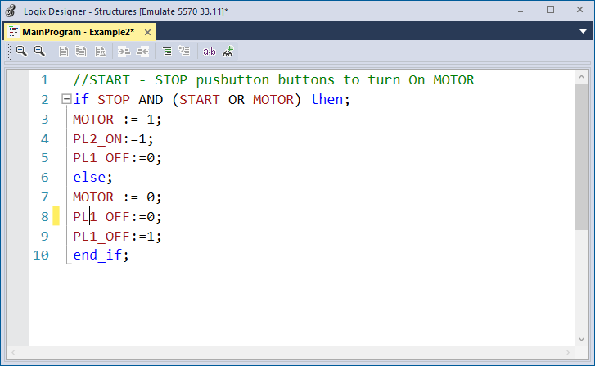
Structured Text
Edit Tag STUDIO 5000
To change a Tag, right click on the Tag and select Browse Tags.
Click on the down arrowhead in the field and select the Tag from the Tag List.
To edit a Tag, single left click on the Tag and type in the edit.

Slide 48
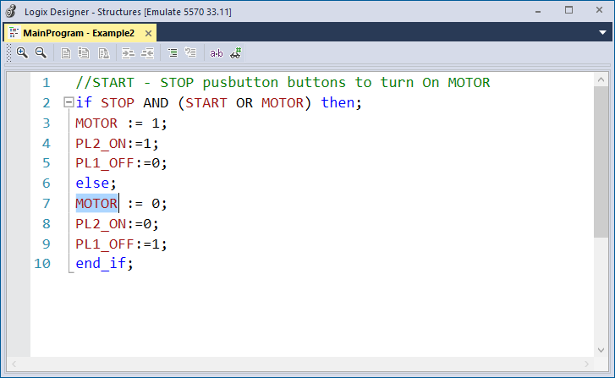
Structured Text
Edit Tag STUDIO 5000
To Delete a Tag, double left click on the Tag to select the tag.
Use the computer’s Delete key to remove the tag.

Slide 49
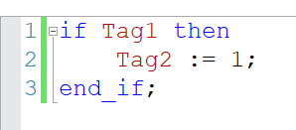

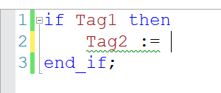
Structured Text
STUDIO 5000 Edits
Uses a – and + box to expand or collapse structures.
Yellow bar to show line being edited and not saved.

Slide 50
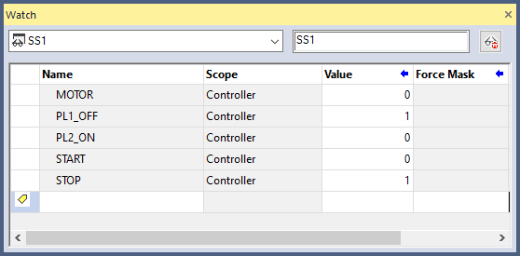
Structured Text
Watch Window STUDIO 5000
Current state values are viewed through the Watch Window.

Slide 51
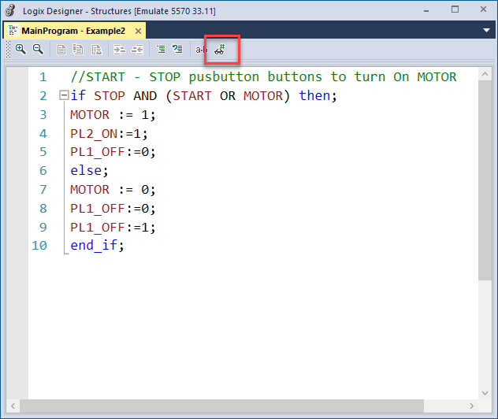
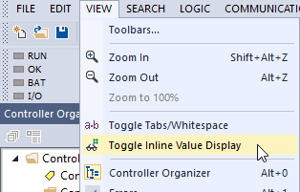
Structured Text
Online Tag Display Editor STUDIO 5000
Menu option to view Tag values on screen.
-OR- a button on the routine’s toolbar.

Slide 52
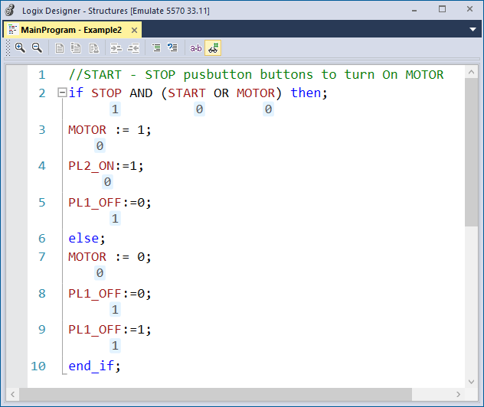
Structured Text
Online Tag Display Editor STUDIO 5000
Menu option to view Tag values on screen.
Tag values shown by tag.
-OR- a button on the routine’s toolbar.

Slide 53
Add and Edit Structure Text SIEMENS

Slide 54
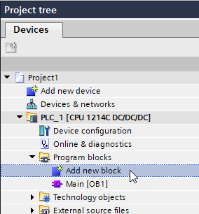
Structured Text
New Structured Text Block SIEMENS
In the Project tree select Add new block.

Slide 55
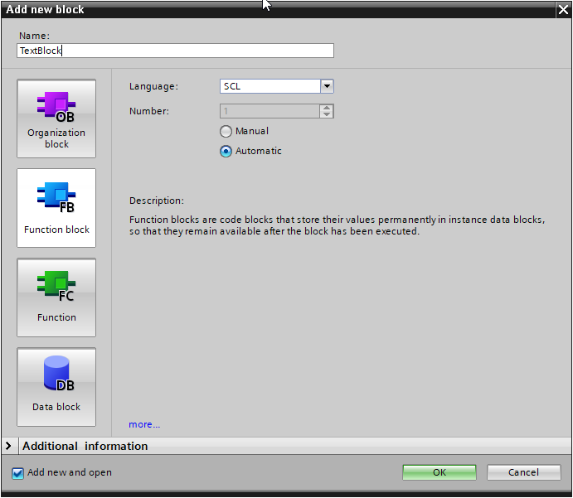
Structured Text
New Structured Text Block SIEMENS
Select either Function block or
Function.
Enter a Name for the block.
From the dropdown Language,
select SCL.

Slide 56
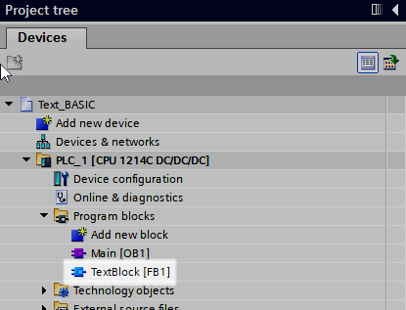
Structured Text
New Structured Text Block SIEMENS
The named program will appear in the Project tree.

Slide 57
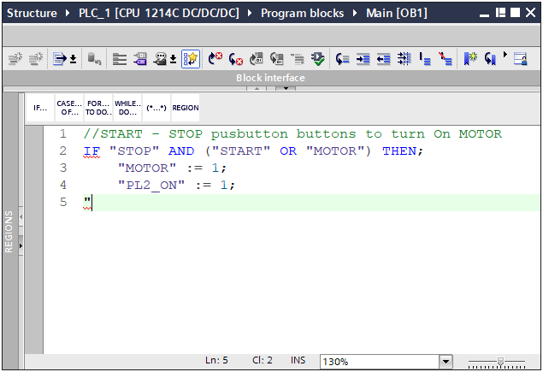
Structured Text
Add Tag with Tag Listing SIEMENS
To add a Tag, type in a quotation mark.

Slide 58
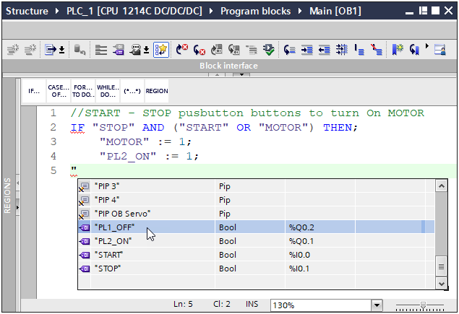
Structured Text
Add Tag with Tag Listing SIEMENS
Select the Tag from the Tag List.

Slide 59
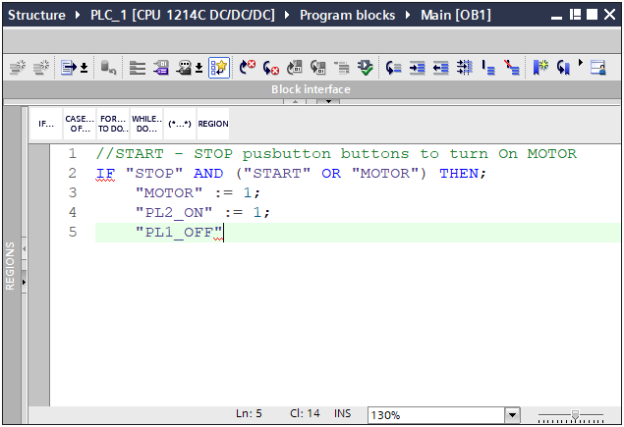
Structured Text
Add Tag with Tag Listing SIEMENS
Tag is added.

Slide 60
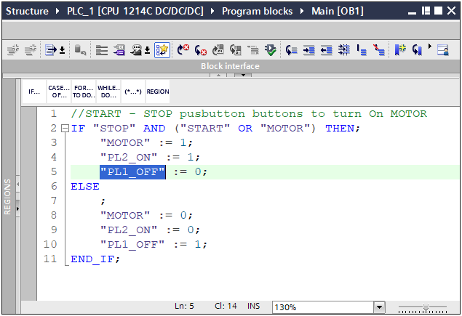
Structured Text
Change a Tag with Tag Listing SIEMENS
To change a Tag, double left click on the Tag to select the tag’s text.
New Tag Name – with the whole Tag selected type in a quotation mark then select the Tag from the Tag List.

Slide 61
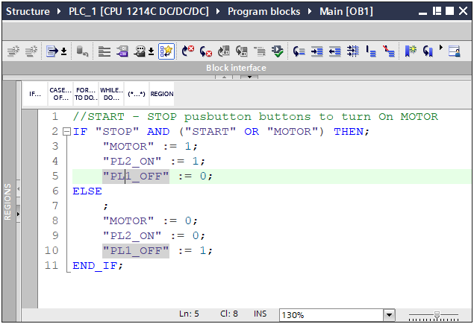
Structured Text
Change a Tag with Tag Listing SIEMENS
Edit Tag Name single left click on the Tag name where to edit and type in change.

Slide 62
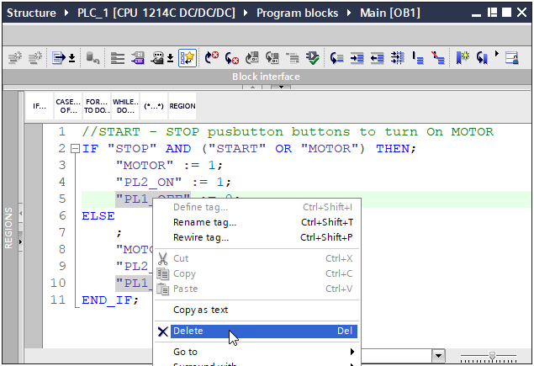
Structured Text
Change a Tag with Tag Listing SIEMENS
To remove a Tag right click and select Delete.

Slide 63
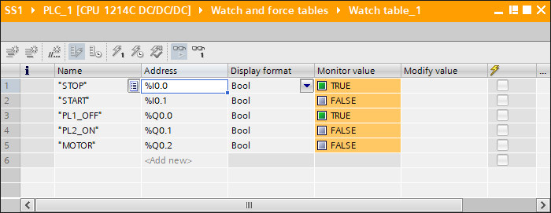
Structured Text
Watch Window SIEMENS
Current state values are viewed through the Watch Window.

Slide 64
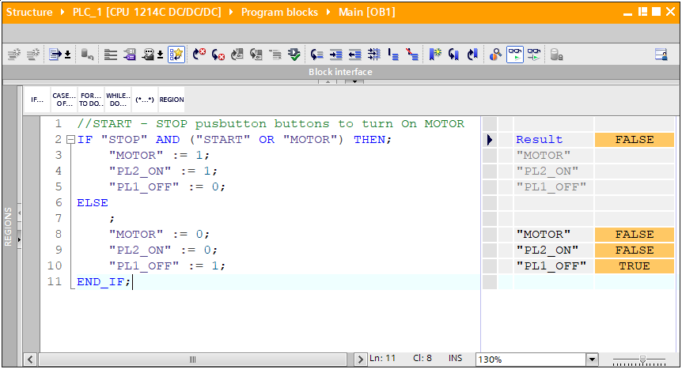
Structured Text
Online Tag Display Editor SIEMENS
Current state values may be viewed in the Editor Window.
By default, the outputs are listed.

Slide 65
Structured Text
Online Tag Display Editor SIEMENS
Current state values may be viewed in the Editor Window.
By default, the outputs are listed.
The Result of FALSE is the IF statement.
FALSE

Slide 66
Structured Text
Online Tag Display Editor SIEMENS
Current state values may be viewed in the Editor Window.
By default, the outputs are listed.
The IF-THEN result is False. Notice the Tags are greyed-out and not status is shown.

Slide 67
Structured Text
Online Tag Display Editor SIEMENS
Current state values may be viewed in the Editor Window.
By default, the outputs are listed.
The ELSE is executed. Notice the Tags are shown with their status.

Slide 68
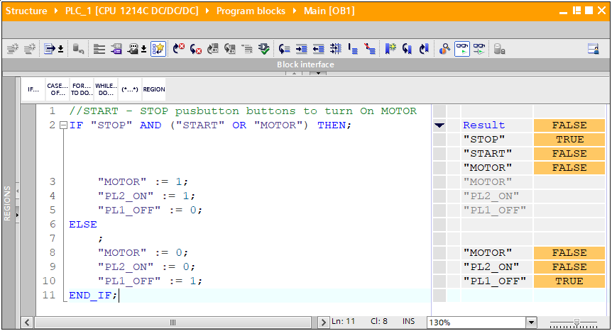
Structured Text
Online Tag Display Editor SIEMENS
To view the inputs, use the Expand arrowhead button.
When the Result is expanded the Tags are shown with their status.

